Slide 1

National Cybersecurity Awareness Month
Andre Hardy

Slide 2



Contents
What do Cybersecurity Professionals do?
Types of Jobs that are available
Why we need you in the workforce
What are the value of certifications?
Frequently Asked Questions (FAQs)

Slide 3




What does a Cybersecurity professional do?
Cybersecurity professionals build, test, and analyze systems to keep data and information safe from attackers and other external threats. They work to identify threats and find ways to keep an organization's internal computer network safe and secure from threats such as malware, phishing, password attacks, and other intrusions. There are, however, varied roles within the industry and a few different cybersecurity careers available.

Slide 4

What does a Cybersecurity professional do?
While the day-to-day tasks of a cybersecurity professional will vary from company to company, here are a few tasks and responsibilities pulled from real job listings:
Monitor network traffic for security incidents and events.
Investigate incidents and respond to events in real time.
Write detailed incident response reports.
Install and operate firewalls, encryption programs, and other security software.
Fix vulnerabilities.
Develop and promote best practices for information security.
Conduct threat research.
Perform periodic risk assessments and penetration tests.

Slide 5
Cyber Security Job Titles
Information Security Analyst
An information security analyst is tasked with protecting sensitive information. They are responsible for developing security strategies and policies, implementing them, ensuring they are up to date and properly utilized, monitoring the results, and making necessary adjustments. At times, an analyst might also organize security training for other employees.
Software Security Engineer
With a strong background in coding and programming languages, software security engineers develop firewalls and intrusion detection systems for their companies. Their skillset has to include a combination of soft skills and hard skills, such as software engineering, problem-solving, building relationships with clients, and learning technology.
Security Architect
A security architect’s main task is to pinpoint the strengths and weaknesses of the client’s systems. It is often said that a security architect must think like a hacker to successfully identify the tactics a hacker would use to breach their systems. Security architects prepare the budget, allocate staff and resources, manage security IT teams, and generate reports for the executive levels.

Slide 6
Cyber Security Job Titles continued
Penetration Tester (Pentester)
If you’ve heard of white hat hackers hired to attempt and breach an organization’s security measures using their hacking skills and software – those would be penetration testers. Their primary role is to simulate a cyber attack to test their clients’ various security programs and firewalls. Their findings are vital for developing better system security policies in the future.
Information Security Crime Investigator
At a cross-section between law enforcement and cybersecurity lies the title of an information security crime investigator or a computer forensics expert. These professionals work on investigating cyberattacks, determining what (or who) caused them, and how exactly the network or computer system was infiltrated. They may not be directly employed by law enforcement, but they closely collaborate with them, as well as different law firms that depend on the expert’s detailed security reports.
Security Consultant
They are independent contractors who offer their knowledge and advice to various organizations about their network security. You will need to possess a wide range of technical, analytical, communication, and computer skills. As with all other IT security job roles, you also need to keep up with all the latest technology news and security recommendations as a consultant.

Slide 7
Why we need you in Cybersecurity
Cybersecurity professionals are in high demand, and this demand is expected to continue to grow in the foreseeable future. Several factors contribute to the strong demand for cybersecurity experts:
Increasing Cyber Threats: The number and complexity of cyber threats, including malware, ransomware, data breaches, and hacking incidents, continue to rise. This drives the need for skilled professionals to defend against these threats.
Digital Transformation: As businesses and organizations increasingly rely on digital technologies, there is a growing need to secure these digital assets. This includes protecting cloud services, IoT devices, and mobile applications.
Cybersecurity Skills Gap: There is a shortage of qualified cybersecurity professionals with the necessary skills and expertise. This shortage has created a competitive job market and increased demand for skilled individuals.

Slide 8
What is the value of cybersecurity certifications?
Proven Skills & Abilities
Industry compliance & regulations
The cybersecurity certification program is important because it provides tangible evidence of a person’s knowledge, skills, and expertise in the field of cybersecurity. It helps individuals stand out from other candidates in the job market and can also help them advance their careers within their current organizations. Employers often require or prefer certifications when hiring or promoting cybersecurity professionals.
Certifications are also important for organizations that need to comply with industry regulations or security standards. Many certifications are recognized by regulatory bodies and can help organizations meet their compliance requirements. It is important for both individuals and organizations to ensure that they have the knowledge, skills, and expertise needed to effectively protect against cyber threats.

Slide 9
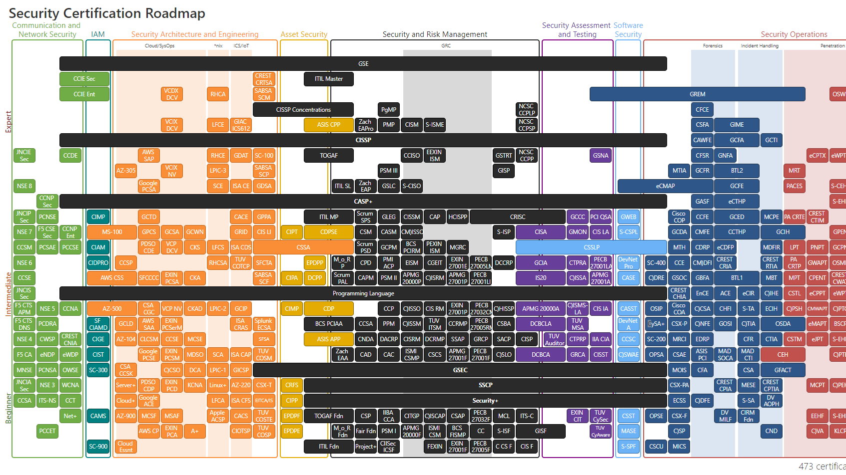
Certifications

Slide 10

References
1. “Update Plans” August 13, 2022 by Paul Jerimy
https://pauljerimy.com/security-certification-roadmap/
2. “What Does a cyber security specialist do?”
https://www.mycomputercareer.edu/news/what-does-a-cyber-security-specialist-do/
3. “What Does a Cybersecurity Analyst Do? 2023 Job Guide.” Written by Coursera • Updated on Oct 2, 2023
https://www.coursera.org/articles/cybersecurity-analyst-job-guide

